Slide 1
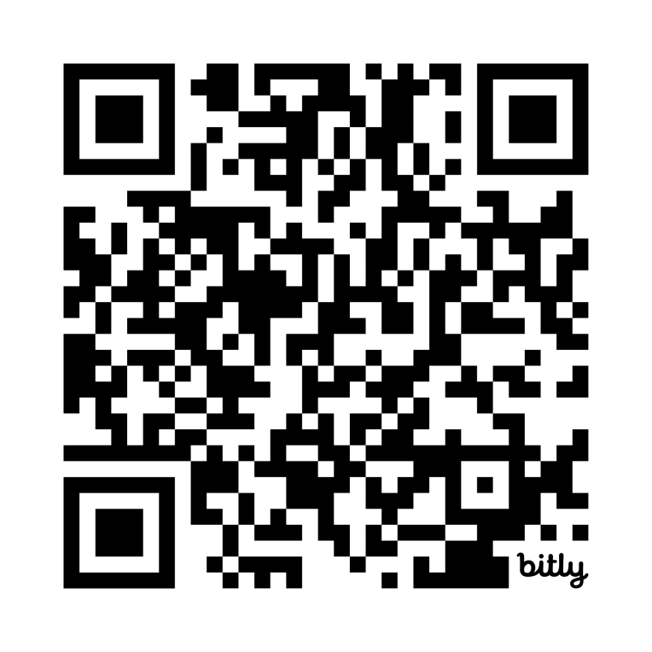
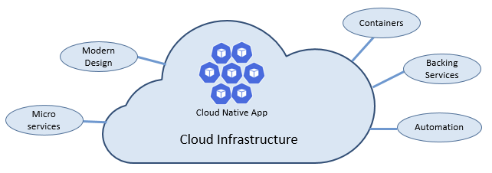
Lab 05 - Cloud-Native Applications
https://bit.ly/B22233

